Slide 1
EyeDepth: Hands-free Selection in VR
David Correia - Nº93576 METI
Advisors: Prof. Joaquim Jorge, A/Prof. Anderson Maciel

Slide 2
Motivation

Slide 3
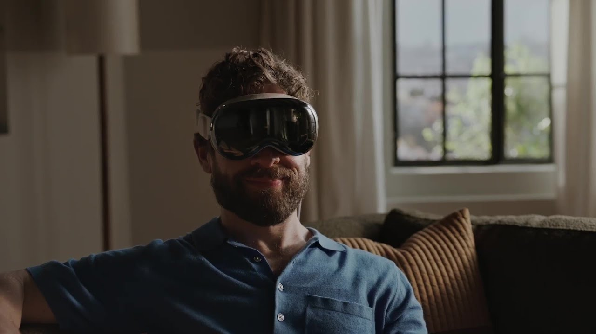
VR is on the Rise

Slide 4
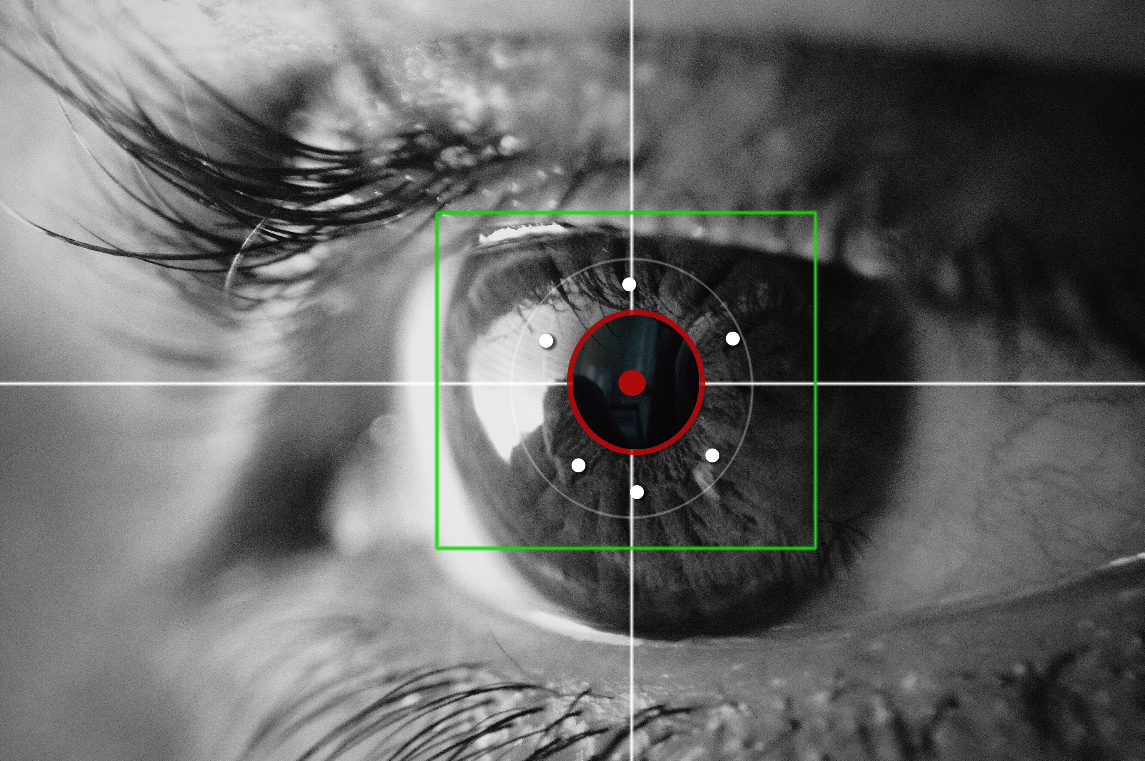
Why Use Eye Tracking ?
Pinpointing: Precise head- and eye-based target selection for augmented reality
- Kytö et al, 2018
Exploring natural eye-gaze-based interaction for immersive virtual reality
- Piumsomboon et al, 2017

Slide 5
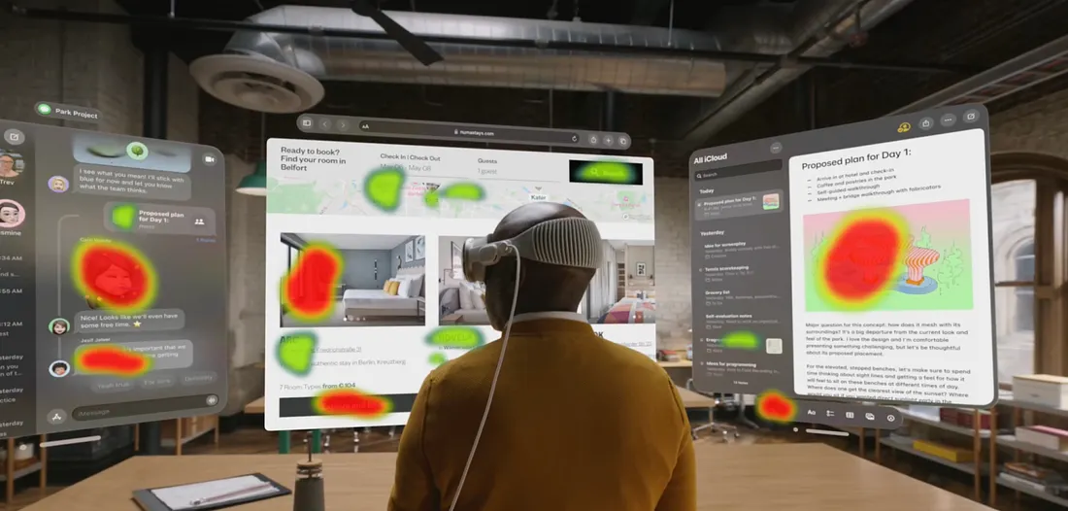
Lack of Depth in EyeTracking
Notes:
Talk about how eye tracking applications don’t always use the 3D Factor, working only with 2D Planes and not committed to full eyetracking controls

Slide 6
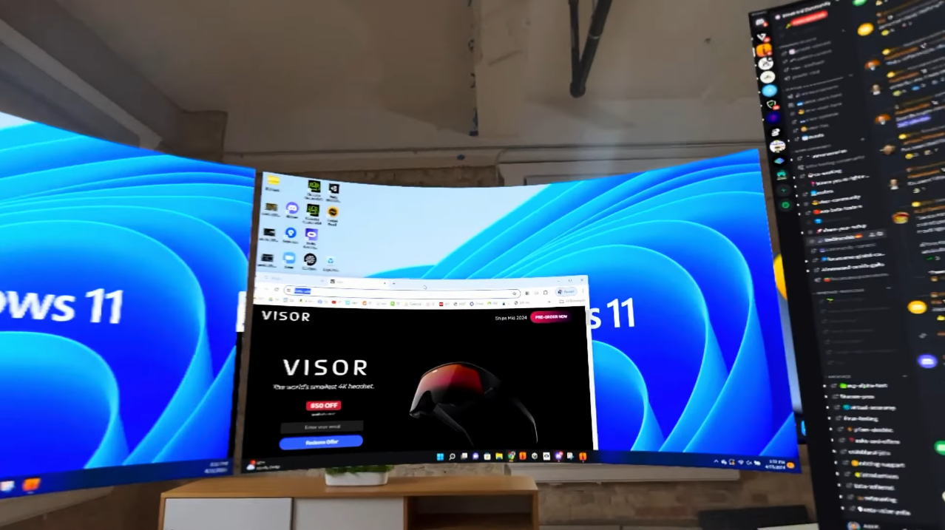
Lack of Depth in EyeTracking
Notes:
Talk about how eye tracking applications don’t always use the 3D Factor, working only with 2D Planes and not committed to full eyetracking controls

Slide 7
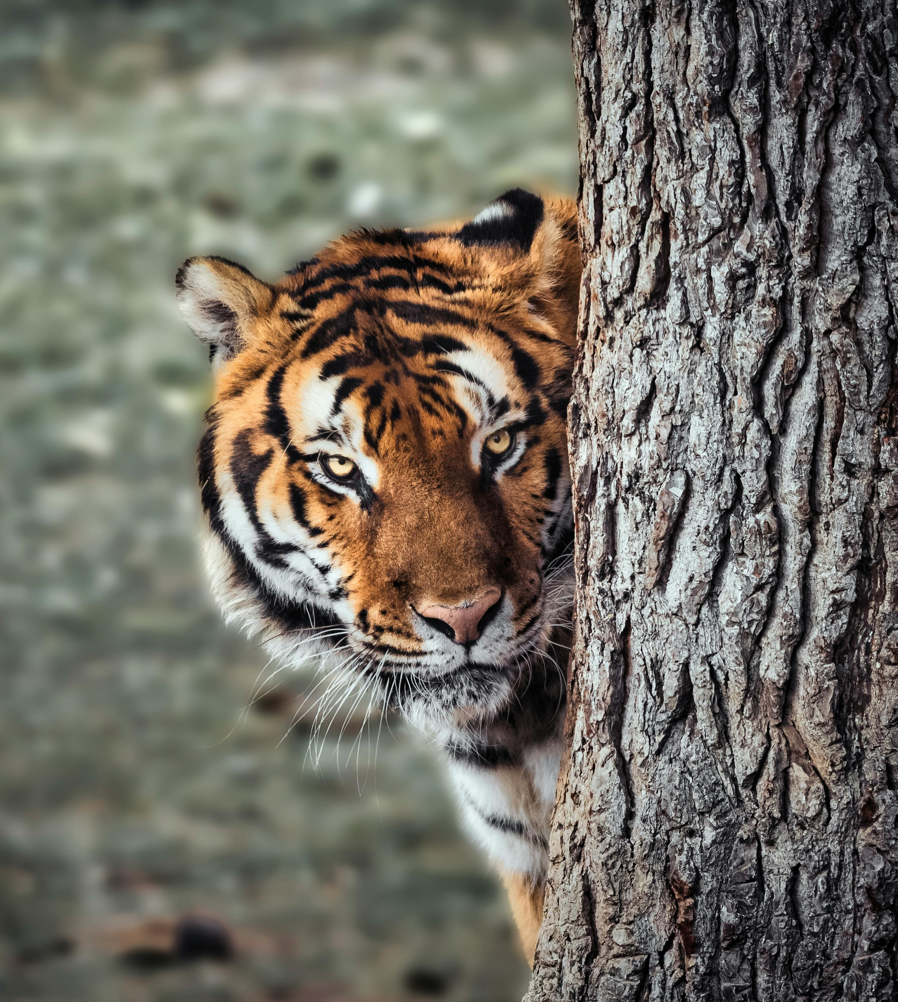
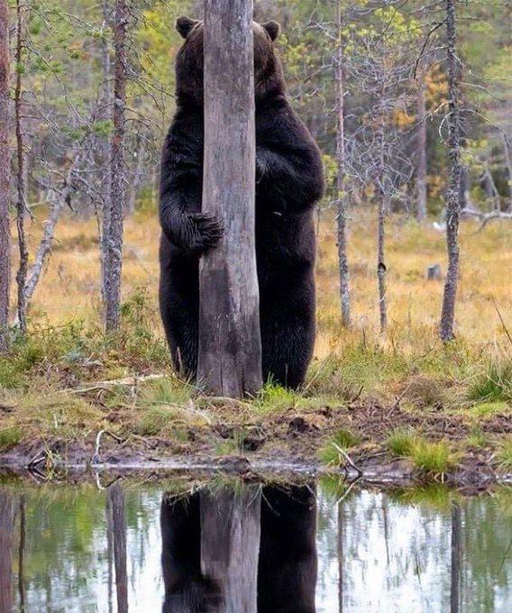
Target Occlusion
Notes:
pode piorar a interação com o ambiente virtual.
Resoluções baixas ou rastreamento impreciso dos olhos

Slide 8
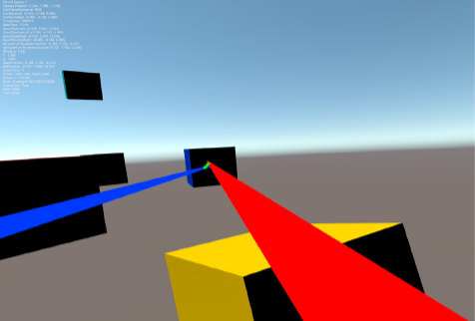
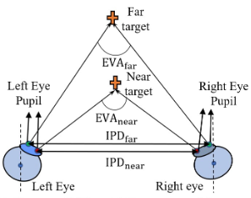
3D Gaze in Virtual Reality: Vergence, Calibration, Event Detection
- Duchowski et al, 2022
What is Vergence?

Slide 9
Research Questions
Ocular vergences measurement in
virtual reality: A pilot study
-Monier et al, 2025
Vergence eye movements in virtual reality -McAnally et al, 2024
Investigating a geometrical solution to the vergence-accommodation conflict for targeted movements in virtual reality -Wang et al, 2025

Slide 10
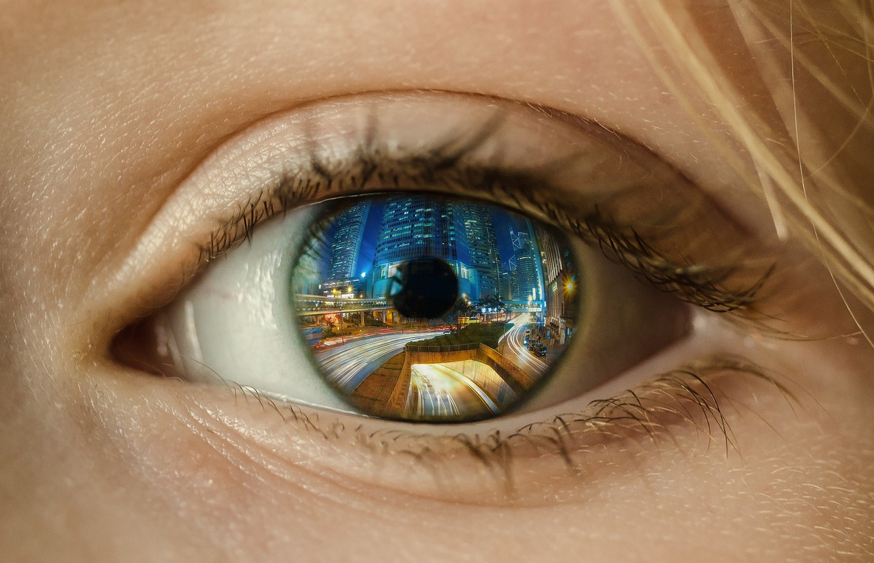
How can vergence techniques be refined to
improve gaze depth estimation in cluttered and immersive VR environments?
RQ 1

Slide 11

How can interaction techniques mitigate inaccurate eye-tracking data and improve the reliability and precision of gaze-based systems in VR?
RQ 2

Slide 12

How do tracking inaccuracies and task complexity contribute to visual
fatigue, and what design strategies can mitigate these effects in VR systems?
RQ 3
Notes:
Como é que as imprecisões dos HMDs e tarefas mais complexas em VR contribuem para fadiga visual? E que estratégias de Design podem mitigar estes problema?
Para resolver estas questões o meu segundo objetivo será avaliar o impacto dos métodos de redução de ruído tanto nas taxas de erro e fadiga visual, determinando se estas técnicas melhoram o desempenho do sistema e o conforto do utilizador.

Slide 13
Vergence Study
Notes:
Nesta secção abordarei algumas das dificulades mais comuns em Eye Tracking.

Slide 14
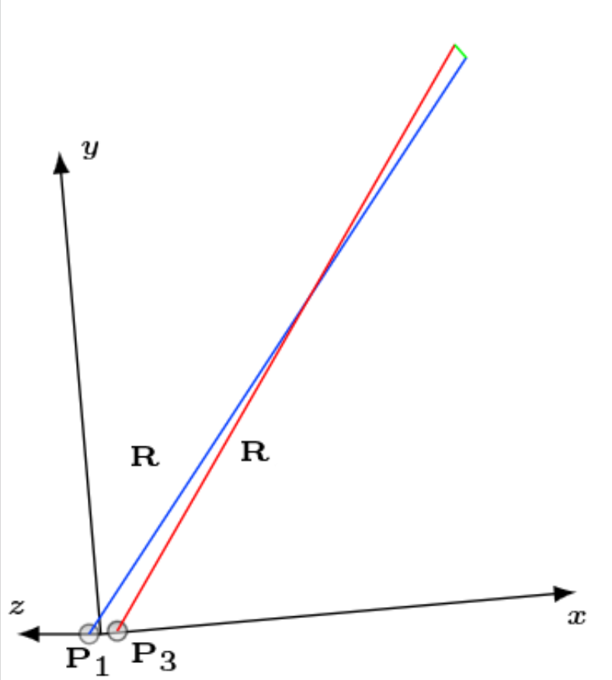


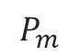

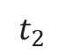

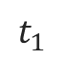

Algorithm Used to Obtain Gaze Depth
$$P_{m}$$
$$t_{1}$$
$$P_{a}= P_{1}+ t_{1}R_{2}$$
$$t_{2}$$
$$P_{m}= \frac{P_{a}+ P_{b}}{2}$$
$$P_{b}= P_{3}+ t_{2}R_{4}$$
$$t_{1}= \frac{\left(P_{3}− P_{1}\right).R_{2}+t_{2}(R_{2}.R_{2})}{(R_{4}.R_{2})}$$
2
4
$$t_{2}= \frac{\left(P_{3}− P_{1}\right).R_{2}\left(R_{4}.R_{4}\right)−\left(P_{3} −P_{1}\right).R_{4}(R_{4}.R_{2})}{{(R_{2}.R_{4})}^{2} −(R_{2}.R_{2})(R_{2}.R_{4})}$$

Slide 15


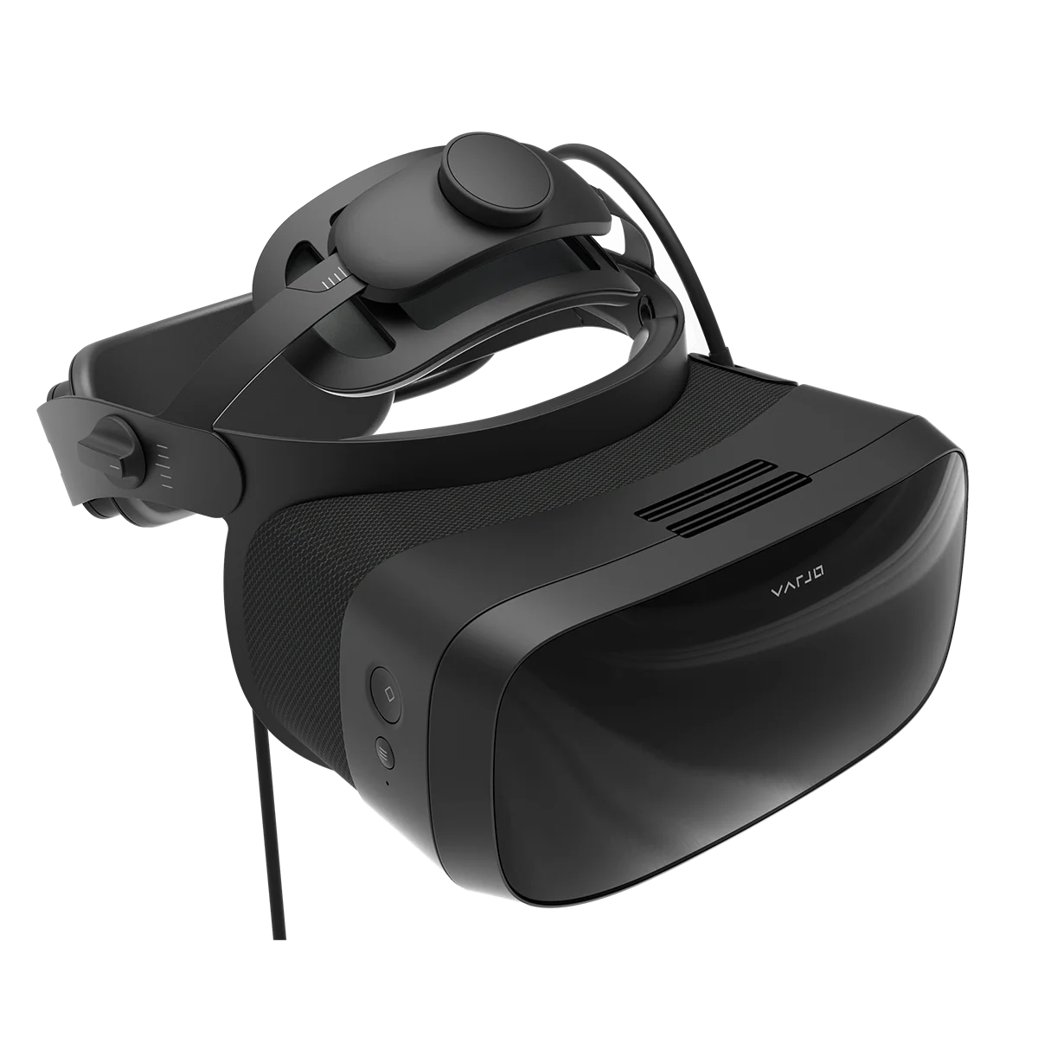

Which VR HMD Did I Choose?
VARJO AERO

Slide 16
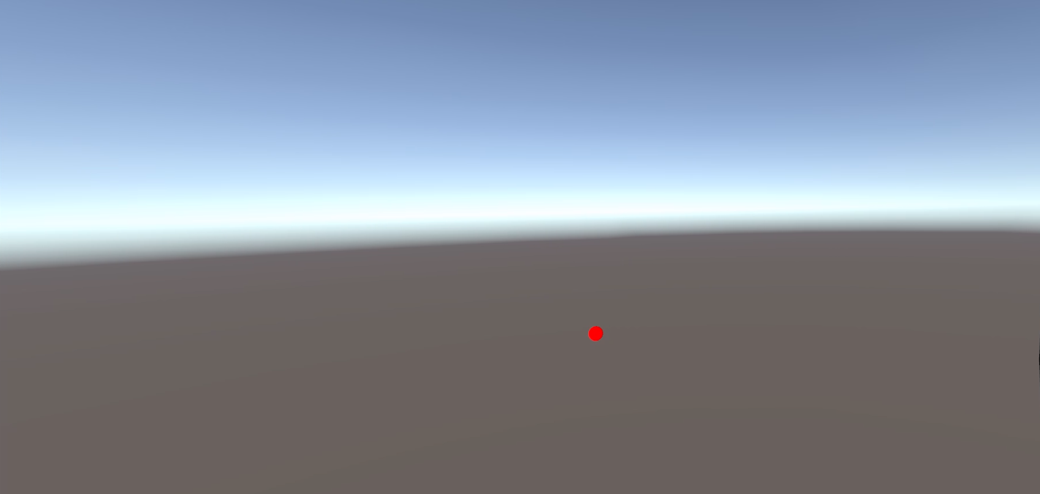
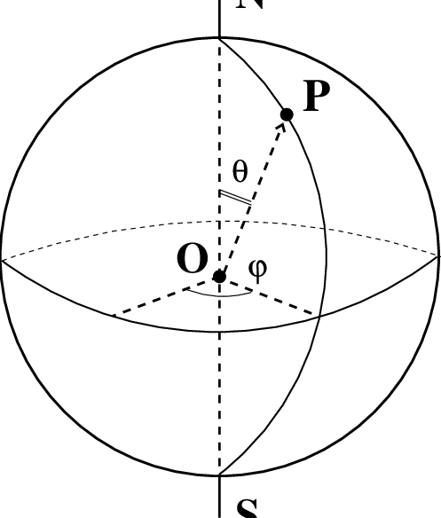
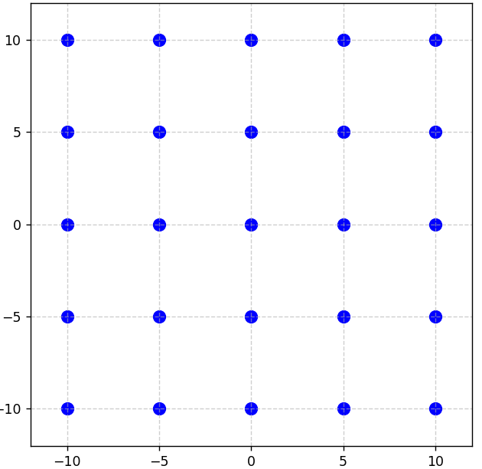
Vergence Study – First iteration
Polar
Azimuth

Slide 17
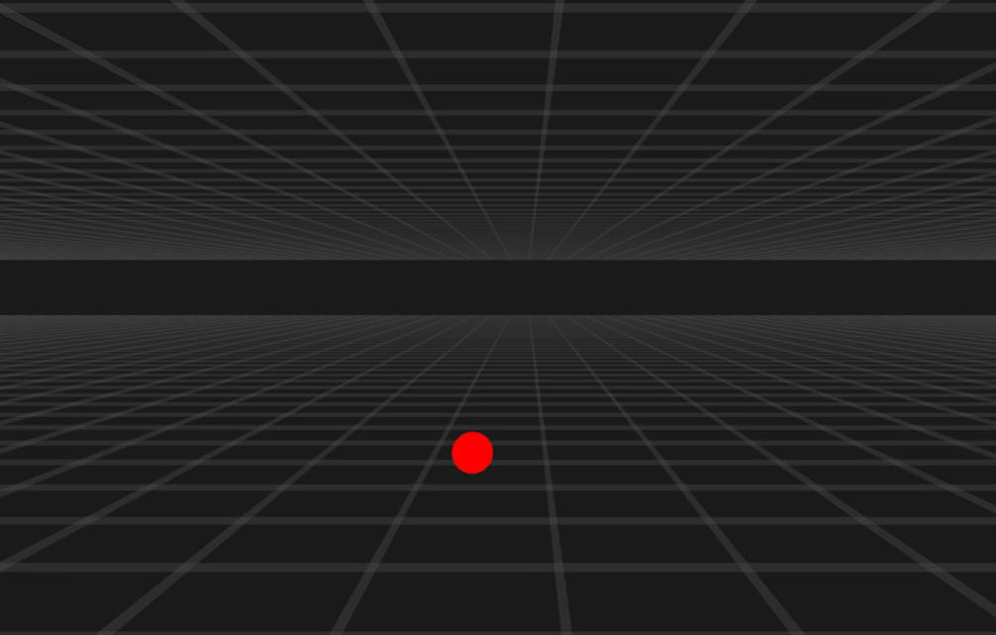
Vergence Study Capture – User is not Looking at Object

Slide 18
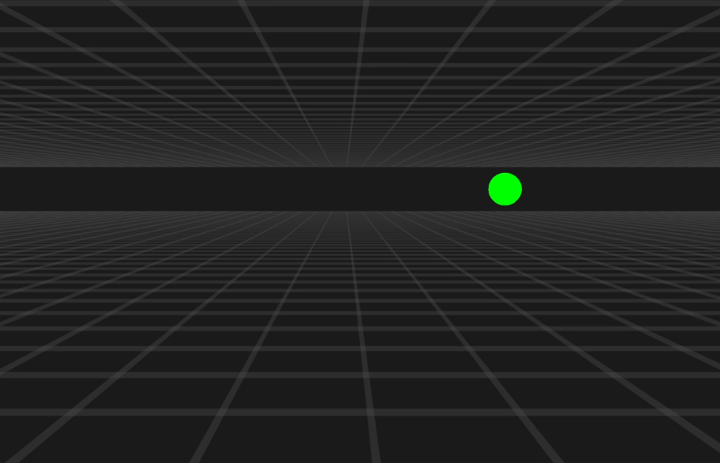
Vergence Study Capture – User Looks at Object
Notes:
Exemplo de quando os Gaze ray combinado dos olhos, dado pelos Varjo, interseta a esfera.

Slide 19
Data Measurements analysis : Horizontal
Vergence Algorithm
Depth (m) | MAE | MAE%
0.3 m | 0.151º | 0.76 %
0.6 m | 0.061º | 0.31%
0.9 m | 0.033º | 0.16%
1.2 m | 0.029º | 0.15%
1.5 m | 0.028º | 0.14%
All Depths Average MAE% | Varjo Provided Data | Vergence Algorithm Data
 | 0.85 % | 0.29%

Slide 20
Data Measurements analysis : Vertical
Vergence Algorithm
Depth (m) | MAE | MAE%
0.3 m | 0.096º | 0.48 %
0.6 m | 0.066º | 0.33%
0.9 m | 0.063º | 0.32%
1.2 m | 0.048º | 0.24%
1.5 m | 0.057º | 0.28%
All Depths Average MAE% | Varjo Provided Data | Vergence Algorithm Data
 | 0.39% | 0.32%

Slide 21
Data Measurements analysis : Depth
Depth (m) | Varjo Provided Depth |  | Vergence Algorithm Depth
 | MAE (m) | MAE% | MAE (m) | MAE%
0.3 | 0.335 | 27.94 | 0.213 | 17.72
0.6 | 0.376 | 31.30 | 0.316 | 26.37
0.9 | 0.496 | 41.36 | 0.553 | 46.12
1.2 | 0.560 | 46.68 | 0.657 | 54.79
1.5 | 0.558 | 46.48 | 0.715 | 59.57
Notes:
Talk about how I compared the Varjo Algorythm to this algorythm

Slide 22
Depth Precision Comparison
Depth (m)
 | 0 | 0.3 | 0.6 | 0.9 | 1.2 | 1.5 | 2
Varjo
Algorithm

Slide 23
Eye Tracking Issues
Notes:
Nesta secção abordarei algumas das dificulades mais comuns em Eye Tracking.

Slide 24
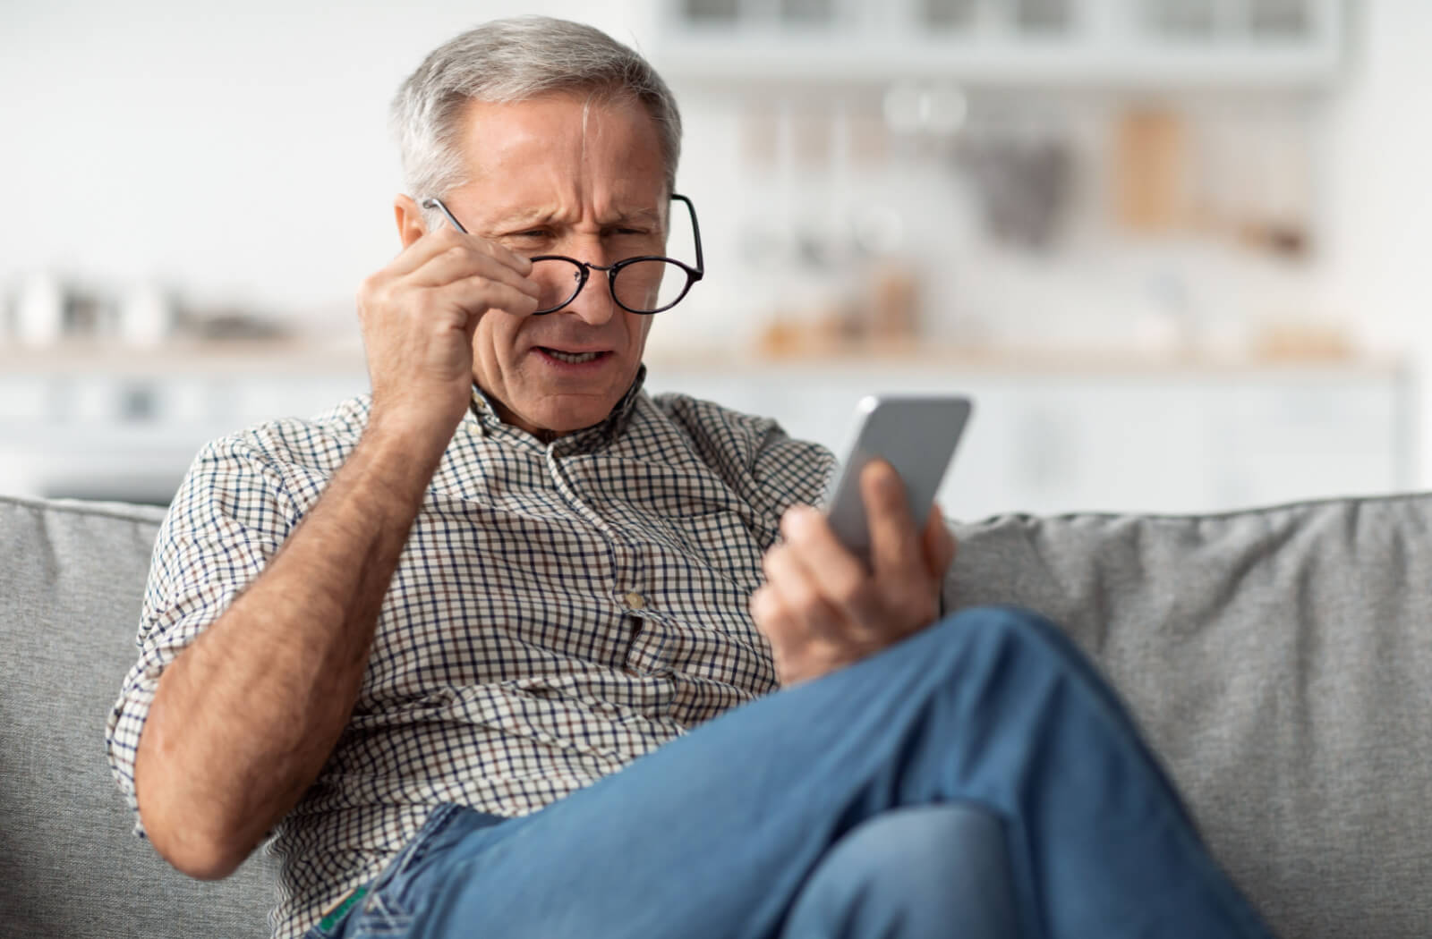
Vision Limits

Slide 25
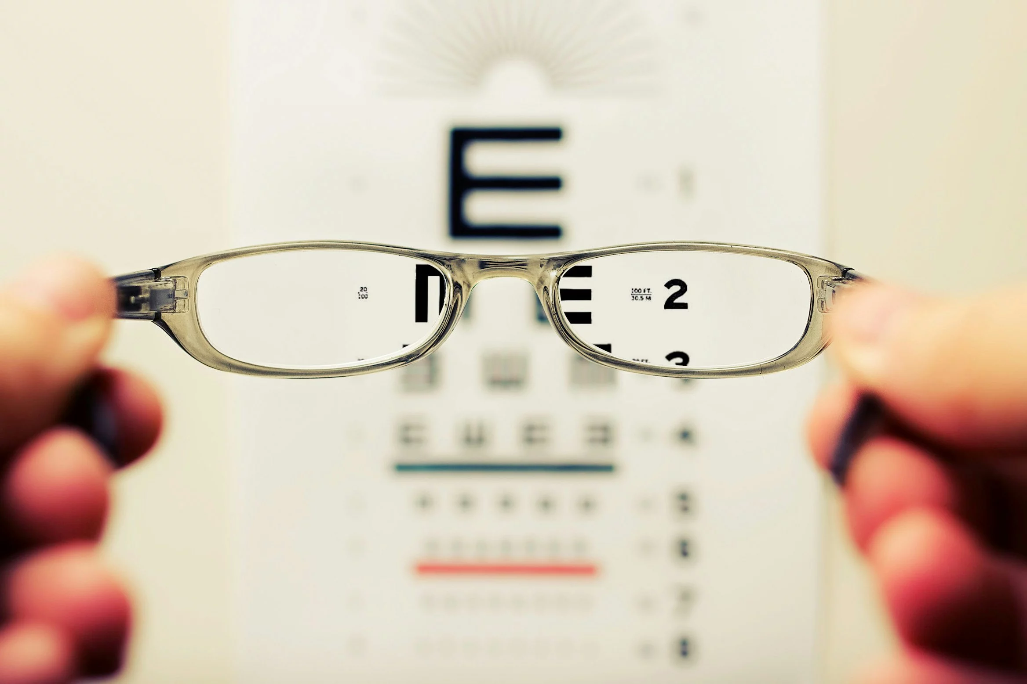
Far away Targets

Slide 26
Eye-Tracking-Based Object Selection
Notes:
Nesta secção abordarei algumas das dificulades mais comuns em Eye Tracking.

Slide 27

Selection

Slide 28
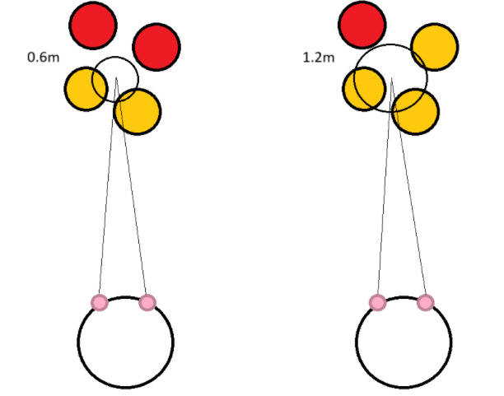
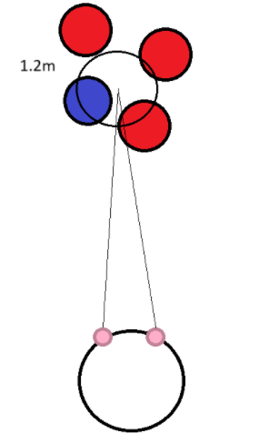
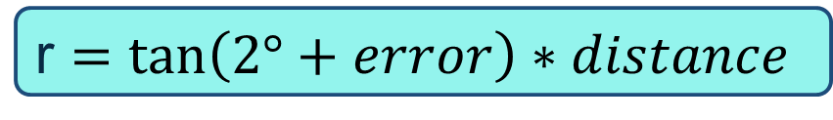
OverlapSphere
r $=\tan\left(2°+error\right)∗distance$
Options
Selection

Slide 29
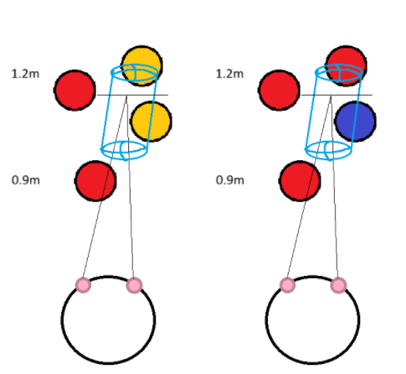
SphereCast
Options
Selection

Slide 30
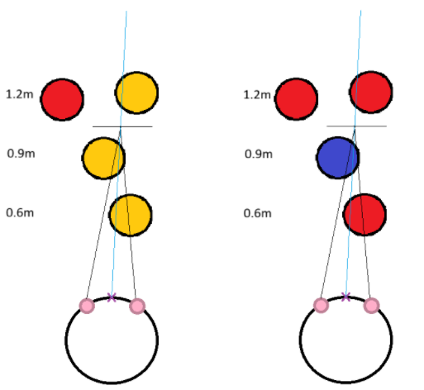
GazeRay
Options
Selection

Slide 31
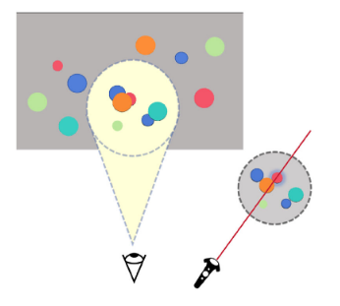
ConeCast – Eyetracking and Controllers
EyeExpand: A Low-Burden and Accurate 3D Object Selection Method With Gaze and Raycasting
- Xu et al, 2025

Slide 32
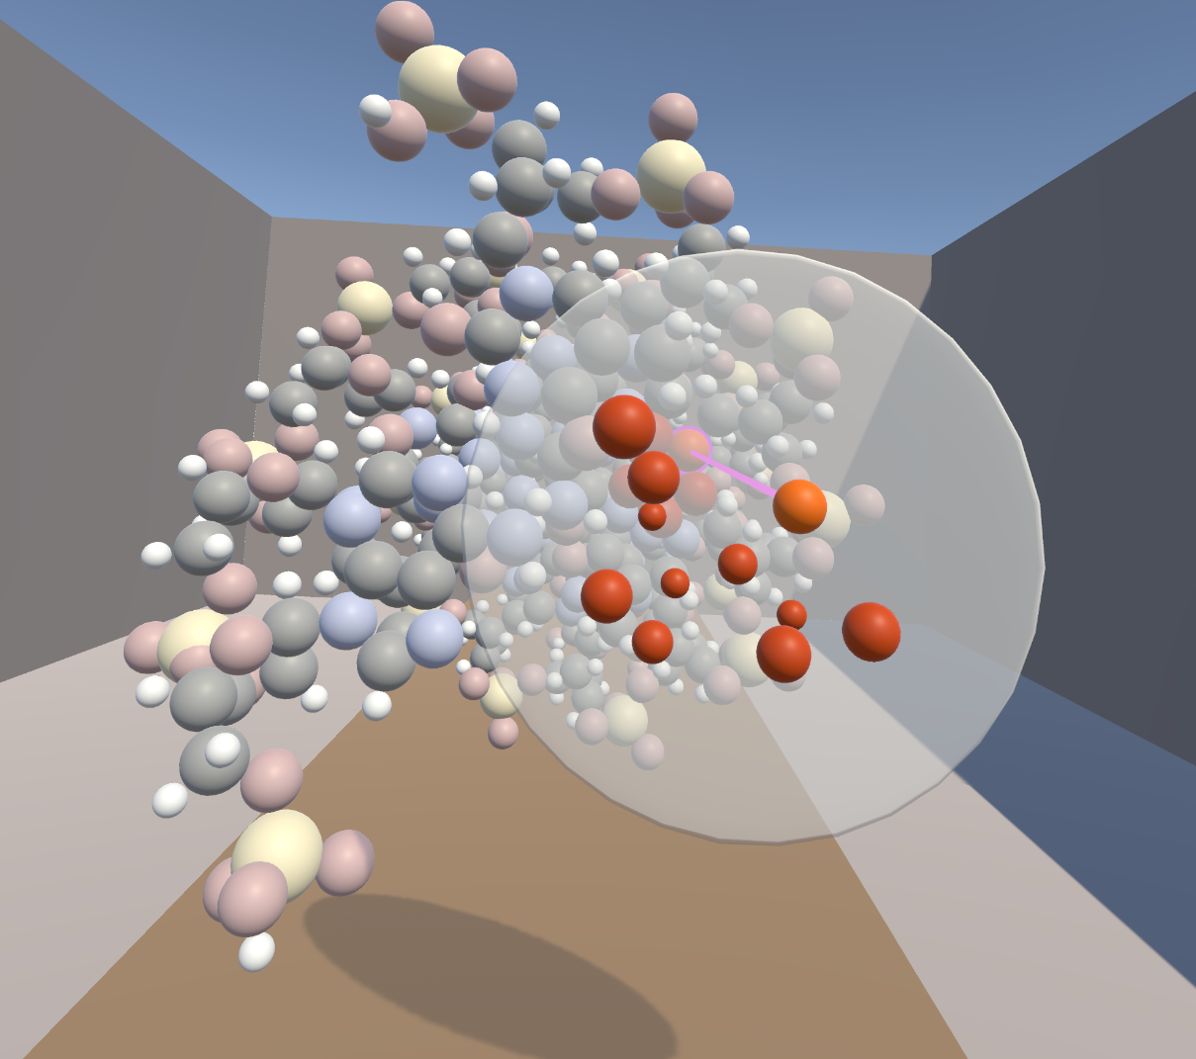
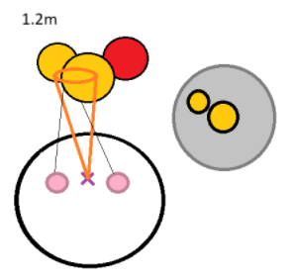
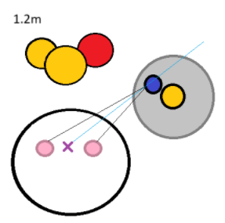
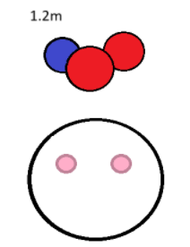
ConeCast – Only EyeTracking
Options
Selection

Slide 33
Confirmation

Slide 34
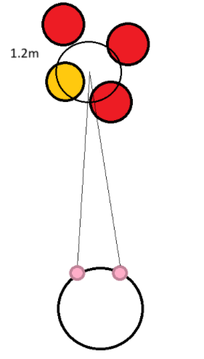

Dwell
1.5 seconds
Selected
Confirmed

Slide 35
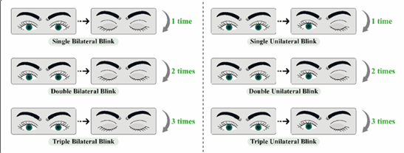
Wink and Double Blink
Design recommendations for voluntary blink
interactions based on pressure sensors
- Fan et al, 2024

Slide 36

Confirmation Test

Slide 37
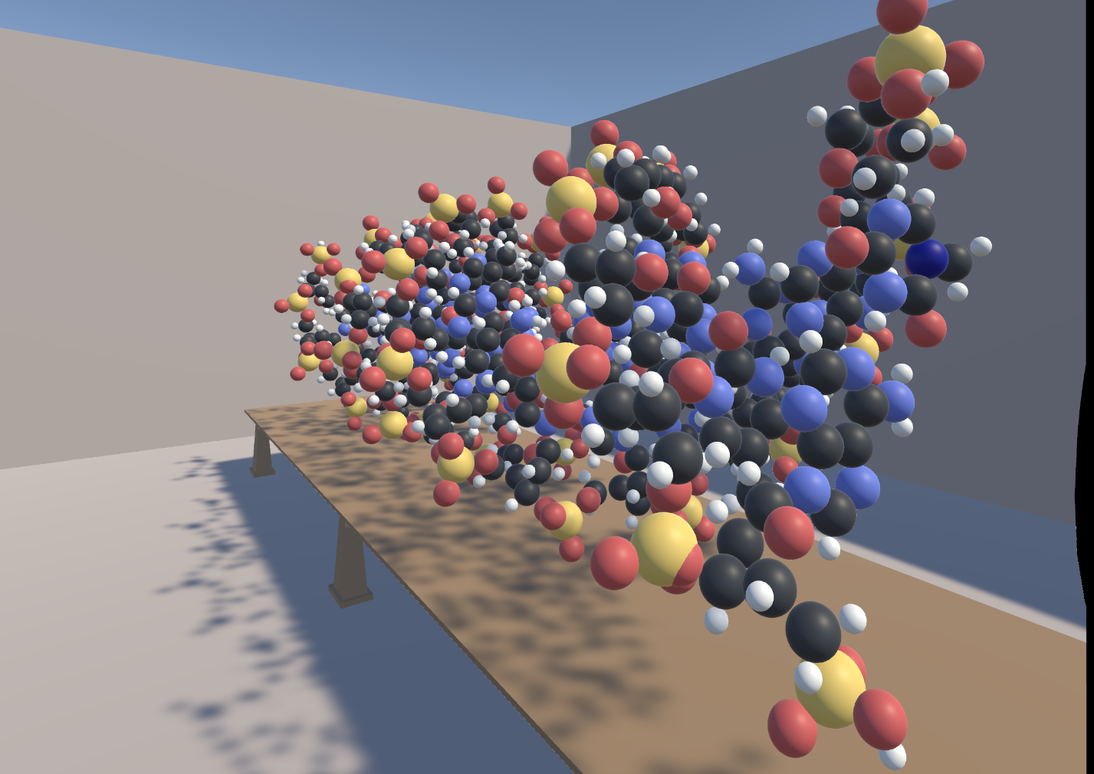
Test Environment
Atom (sphere) | Diameter (m)
Hydrogen (White) | 0.0248
Carbon (Black) | 0.0487
Nitrogen (Blue) | 0.0499
Oxygen (Red) | 0.0512
Phosphorus (Yellow) | 0.0697

Slide 38
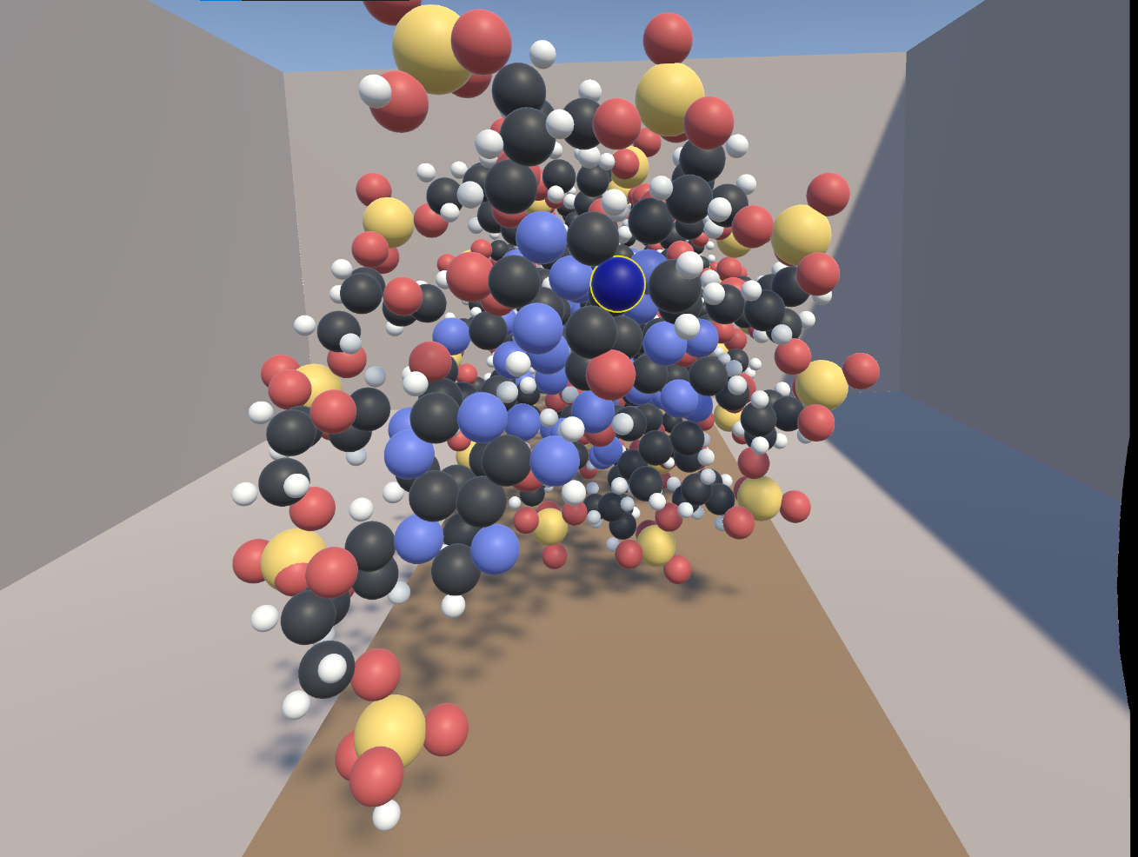
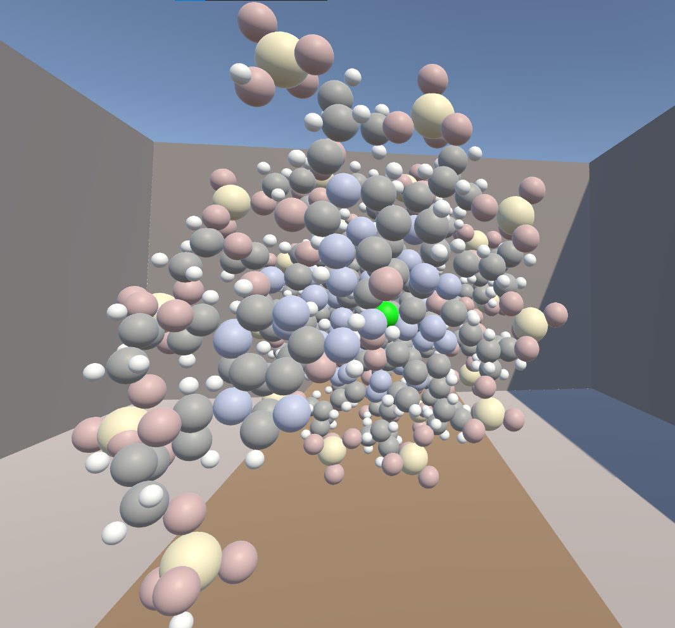
Less Saturated

Slide 39
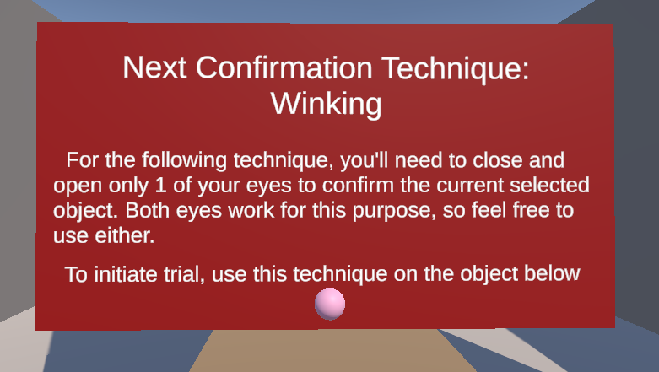

Slide 40
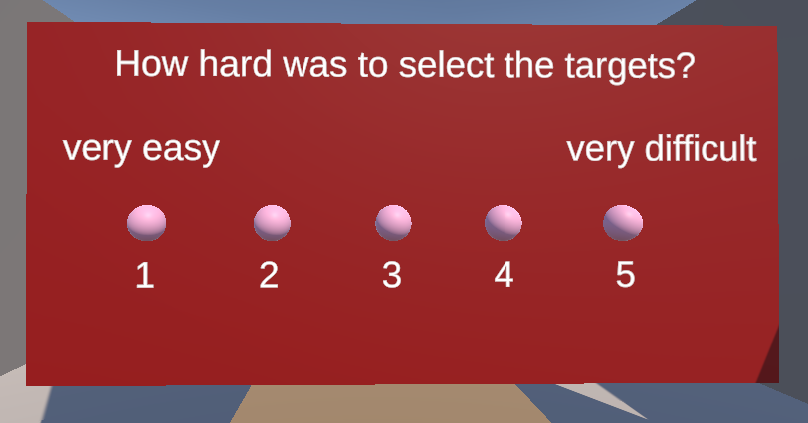

Slide 41
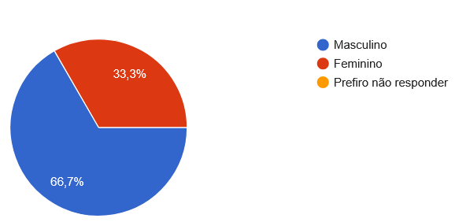
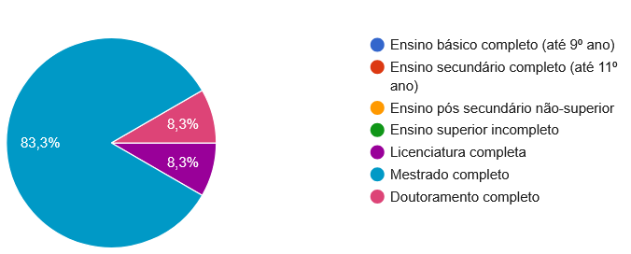
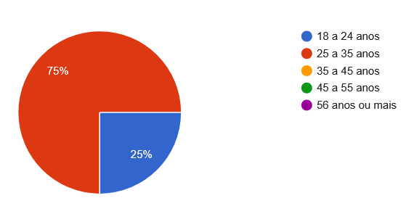
Participants
Education Level
Age
Sex

Slide 42
Participants - 12
Age

Slide 43
Participants – Eye Conditions
Eye Condition | Number of Participants (12)
Astigmatism | 2
Myopia + Astigmatism | 4
None | 6

Slide 44
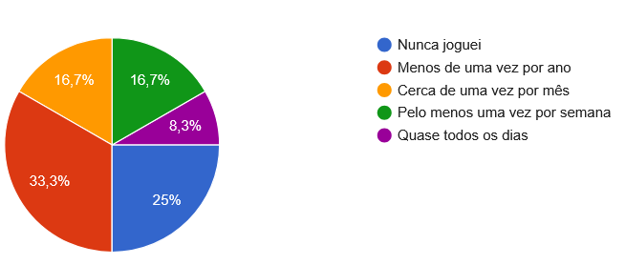
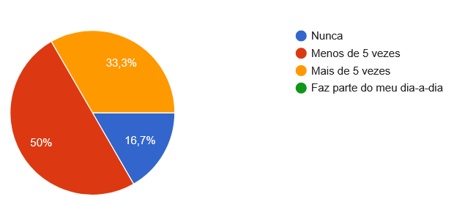
Participants – Previous Experience
VR
3D Games

Slide 45
Participants – Previous Experience
VR

Slide 46


Slide 47
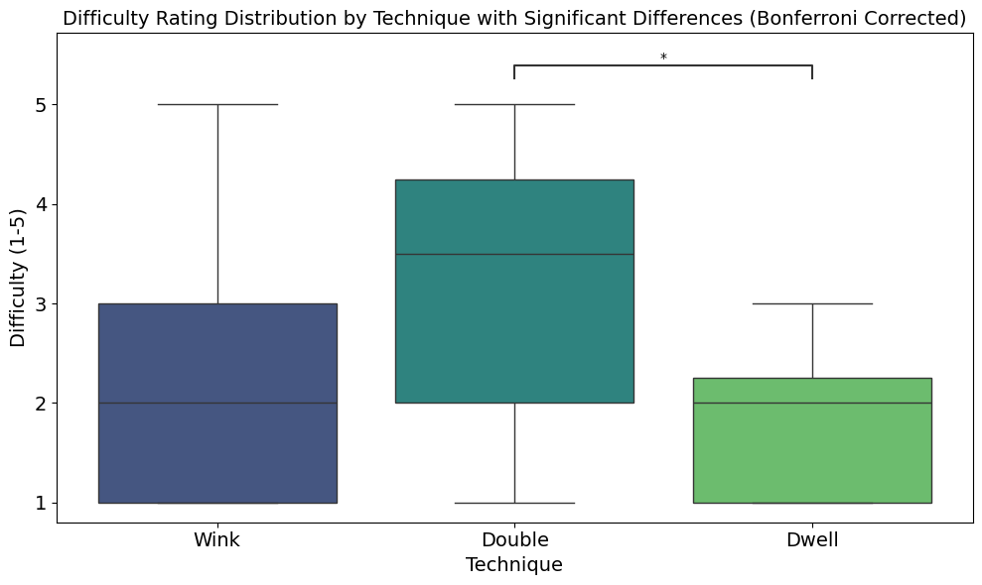
Wink and Double Blink
Design recommendations for voluntary blink
interactions based on pressure sensors
- fan et al, 2024

Slide 48
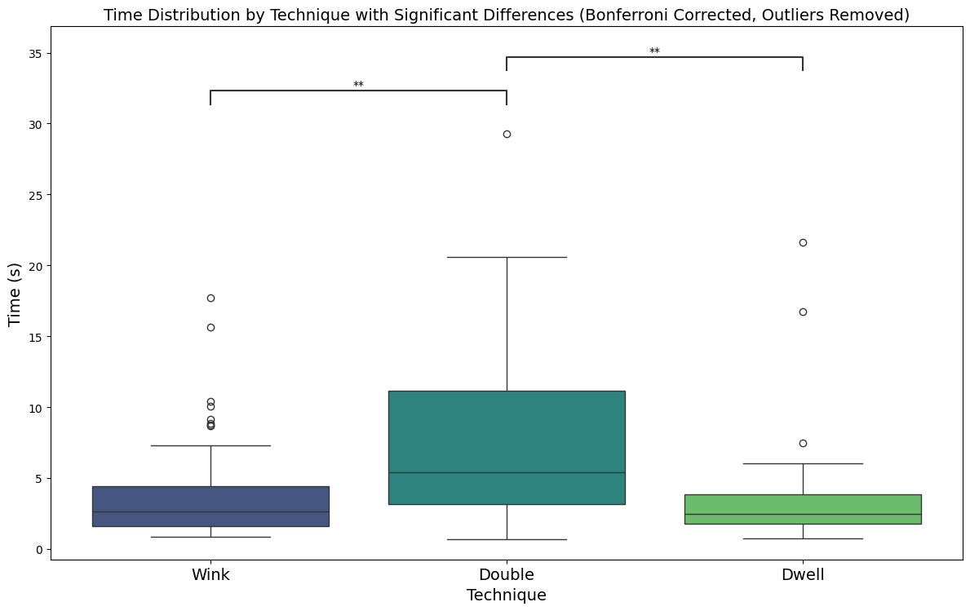

Slide 49
Accuracy
Technique | Incorrect (False) | Correct (True) | Accuracy (%)
Double Blink | 15 | 40 | 72.73
Dwell | 18 | 37 | 67.27
Wink | 14 | 41 | 74.55

Slide 50

Confirmation Test Results
Speed
Wink = Dwell > Double Blinking
Accuracy
Wink > Double Blinking > Dwell

Slide 51
Selection Test

Slide 52
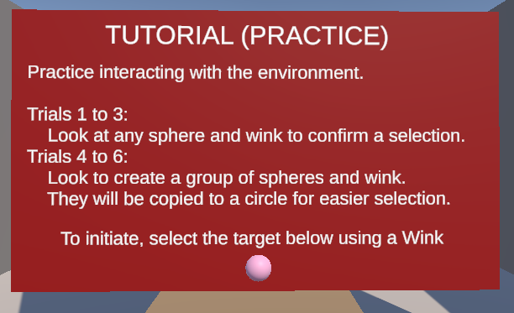

Slide 53
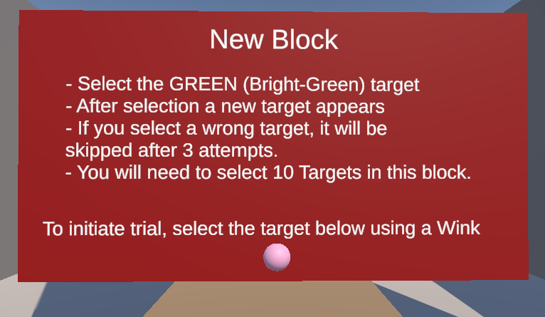

Slide 54

Test Subject Criteria
Notes:
Bastante abrangente, pessoas que não tenham problemas de visão. Pelo menos 20-30 utilizadores.

Slide 55
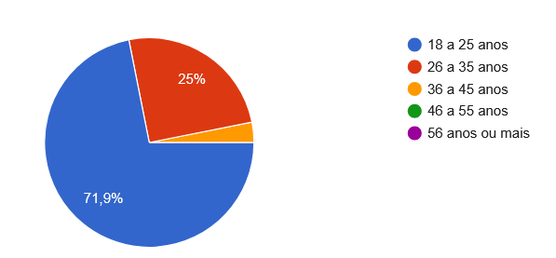
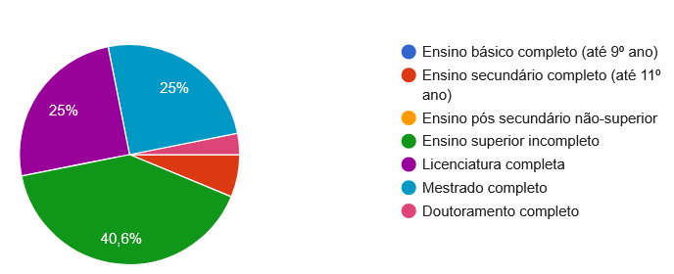
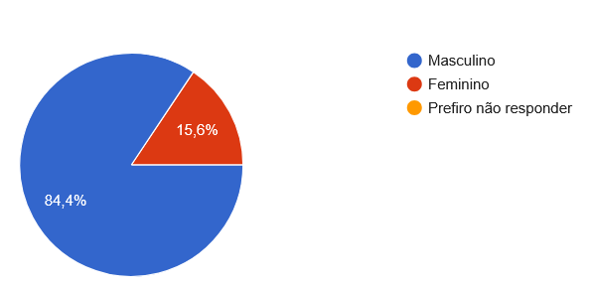
Participants
Education Level
Age
Sex

Slide 56
Participants - 32
Age

Slide 57
Participants – Eye Conditions
Eye Condition | Number of Participants (32)
Myopia | 9
Myopia + Astigmatism | 2
Hyperopia | 1
Dyschromatopsia (Color Blindness ) | 2 (one also has Myopia)
None | 19

Slide 58


Participants – Eye External Conditions
Contact Lenses
Eye Correction Surgery

Slide 59

Participants – Previous Experience
VR

Slide 61


Slide 62
Accuracy
Trial/Technique | Accuracy
ConeCast | 0.9818
OverlapSphere | 0.7091
RayCast | 0.9273
SphereCast | 0.9273

Slide 63


Slide 64


Slide 65
Wrong Selections
Technique | Count (420 trials/technique) | Average Distance (m)
OverlapSphere | 64 | 0.1915
SphereCast | 16 | 0.2281
RayCast | 16 | 0.2293
ConeCast | 4 | 0.2625

Slide 66


Participants Discomfort
1 - None
5 - Severe
Tired Vision
General Discomfort

Slide 67


Participants Discomfort
1 - None
5 - Severe
Dizziness
Nausea

Slide 68
Participants Discomfort
1 - None
5 - Severe
Tired Vision
General Discomfort
Dizziness
Nausea

Slide 69
Selection Test Results
ConeCast
Neer Perfect Accuracy and fast
SphereCastRayCast
High Accuracy and fast
OverlapSphere
Lower Accuracy and slower

Slide 70
Conclusion
Notes:
Concluíndo, a ideia do meu trabalho é...

Slide 71




Vergence Potential in VR

Slide 72
EyeExpand
ConeCast
VS

Slide 73
Assure Precision and Comfort
Define Guidelines
Notes:
O meu trabalho procura desenvolver diretrizes para sistemas de Eye Tracking mais fiáveis e naturais, que garantam precisão e conforto.

Slide 74
Vergence Algorithms are not enough
Define Guidelines
Notes:
O meu trabalho procura desenvolver diretrizes para sistemas de Eye Tracking mais fiáveis e naturais, que garantam precisão e conforto.

Slide 75
Precise Depth Range
(0.3m – 1.5m)
Define Guidelines
Notes:
O meu trabalho procura desenvolver diretrizes para sistemas de Eye Tracking mais fiáveis e naturais, que garantam precisão e conforto.

Slide 76
Future Works can Build Upon these Results

Slide 77

Enhance Calibration
Process

Slide 78
Try VR HMDs with different properties

Slide 79
Redo Test in a Natural Environment

